Slide 1

PHS650: Rigor and Reproducibility in the Social, Behavioral, and Population Health Sciences
Dr. Katherine Schaumberg
Wk 3 – Lecture 1

Slide 2
Pre-registration & Registered Reports
Biases are inherent throughout the scientific process.
Pre-registration is a tool to produce more rigorous (less biased) results
Some protection from p-hacking/post-hoc hypothesis revision
Registered reports are formal submission of pre-registration to a journal
Both ideally completed before study initiation and recruitment

Slide 3
Moving Towards Advanced OS Skills
Beginner
Intermediate
Advanced
Posting pre-prints
Pre-registration; registered reports
Curating data
Developing synthetic data
Publishing reproducible and accessible code
Use of version control repositories
Publishing comprehensive protocols
Publishing ‘open access’

Slide 4
Pre-registration, Registered Reports, and Preprints
Preprint | Pre-Registration | Registered Report
Non peer-reviewed | Non peer-reviewed | Peer-reviewed
Self-published on open access repository | Self-published on open access repository | Published in Journal
No pre-specification of analysis | Vary widely in specificity (more specified pre-registration is generally viewed as favorable) | Specificity can be reviewer dependent
Can be updated | Timestamped | Accepted before study or analysis begins
Swift dissemination of results | Favorable for future papers; required by some journals | Conditional guarantee of acceptance

Slide 5
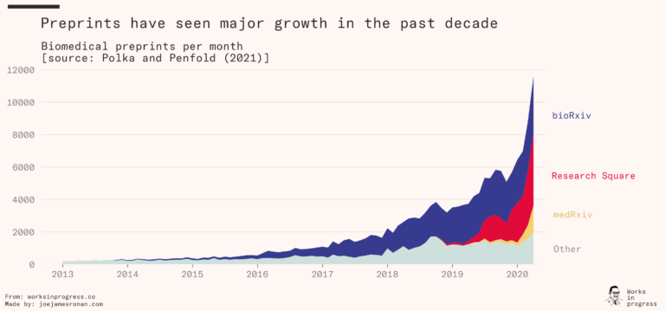
The rise of preprints

Slide 6
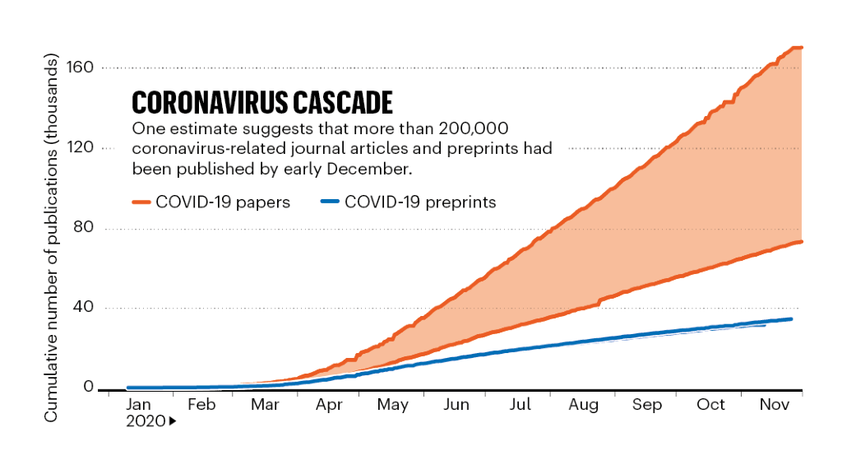
The Peer Review Process
Peer review was not common until the 1970s
Developed for quality control
Creates dissemination lag
Unpaid and unincentivized
Editors continue to have outsized power in triage
N papers submitted (and peer review requests) grow each year
Not standardized. A survey of authors reported:
43% of reviews are high quality, guiding them to improve their analysis, communicate their results better, and put them in context
27% are reported to be low quality, rushed, vague, excessively demanding, or personally insulting

Slide 7
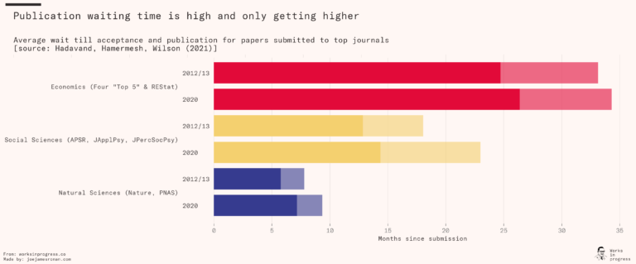
Peer review limitations

Slide 8
OSF Demo

